Slide 1
Macroeconomics ECON 101
Unemployment and Inflation
(Chapter 5)
Instructor: Muhebullah Karimzada
Notes:
If this PowerPoint presentation contains mathematical equations, you may need to check that your computer has the following installed:
1) MathType Plugin
2) Math Player (free versions available)
3) NVDA Reader (free versions available)

Slide 2
Chapter Outline
5.1 Measuring the Unemployment Rate and the Labour Force Participation Rate
5.2 Types of Unemployment
5.3 Explaining Unemployment
5.4 Measuring Inflation
5.5 Using Price Indexes to Adjust for the Effects of Inflation
5.6 Real versus Nominal Interest Rates
5.7 Does Inflation Impose Costs on the Economy?

Slide 3
Measuring Unemployment and Inflation
In the last chapter, we learned about how to measure total output—a critical first step in understanding the economy.
In this chapter we learn how to measure unemployment and inflation.
These are very important and commonly-used macroeconomic concepts.
If we want to talk intelligently about them, we need to be clear about what they mean.

Slide 4
Measuring Unemployment
There are more than 37 million people in Canada, and monitoring and reporting on their activities regularly would be very difficult and costly.
Instead, Statistics Canada reports estimates of employment, unemployment, and other statistics related to the labour force each month.
Labour force: The sum of employed and unemployed workers in the economy.
Of these statistics, the most watched is known as the unemployment rate: the percentage of the labour force that is unemployed.

Slide 5
The Labour Force Survey
Each month, Statistics Canada conducts the Labour Force Survey (LFS).
~56 000 households selected to be “representative”
Household members of “working age” (15+ years old)
Asked about employment
Also asked about recent job-search activities
People are then classified as:
Employed: did paid work, unpaid work for a family business, or worked for themselves (or were temporarily away from their jobs).
Unemployed: Someone who is not currently at work but who is available for work and who has actively looked for work during the previous four weeks.
Not in the labour force, if neither of the above apply.

Slide 6
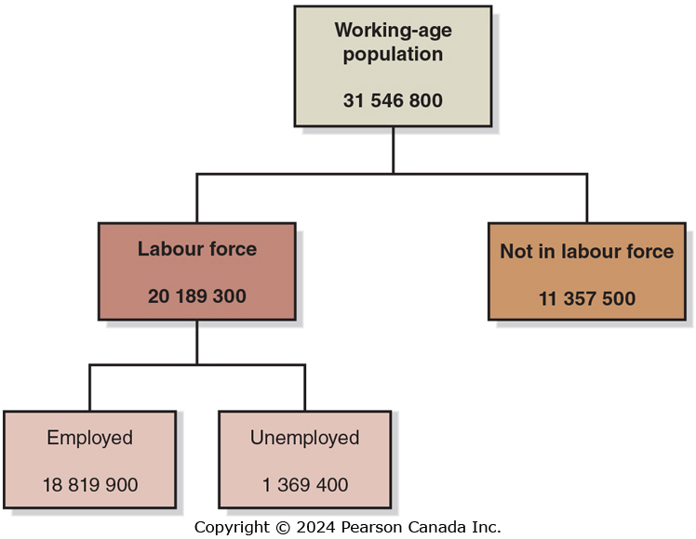
Figure 5.1 The Employment Status of the Working-Age Population, January 2022 (1 of 3)
Statistics Canada classifies people as employed, unemployed or not in the labour force. The labour force is all people who are employed plus those who are unemployed.
SOURCES: Statistics Canada, “Labour Force Characteristics by Sex and Detailed Age Group, Month, Unadjusted
for Seasonality (×1,000),” Table 14-10-0017-01; and “Reason for Not Looking for Work, Monthly, Unadjusted for
Seasonality (×1,000),” Table 14-10-0127-01.

Slide 7
Figure 5.1 The Employment Status of the Working-Age Population, January 2022 (2 of 3)
Based on StatsCan estimates, we calculate several important macroeconomic indicators.
The most-watched is the unemployment rate:
Also important are the labour force participation rate (the percentage of the working-age population in the labour force

Slide 8

Figure 5.1 The Employment Status of the Working-Age Population, January 2022 (3 of 3)
The employment-population ratio (the percentage of the working-age population that is employed):
SOURCES: Statistics Canada, “Labour Force Characteristics by Sex and Detailed Age Group, Month, Unadjusted
for Seasonality (×1,000),” Table 14-10-0017-01; and “Reason for Not Looking for Work, Monthly, Unadjusted for
Seasonality (×1,000),” Table 14-10-0127-01.

Slide 9
Problems with Measuring the Unemployment Rate
The unemployment rate measured by Statistics Canada is not a perfect measure of joblessness in the economy. Why?
It may understate unemployment:
Distinguishing between people who are unemployed and not in the labour force requires judgment (should we exclude “discouraged workers”?)
It only measures employment, not intensity of employment (full-time vs. part-time; some people are underemployed)
It may overstate unemployment:
People might claim falsely to be actively looking for work
May claim to be unemployed to evade taxes or keep criminal activity unnoticed

Slide 10
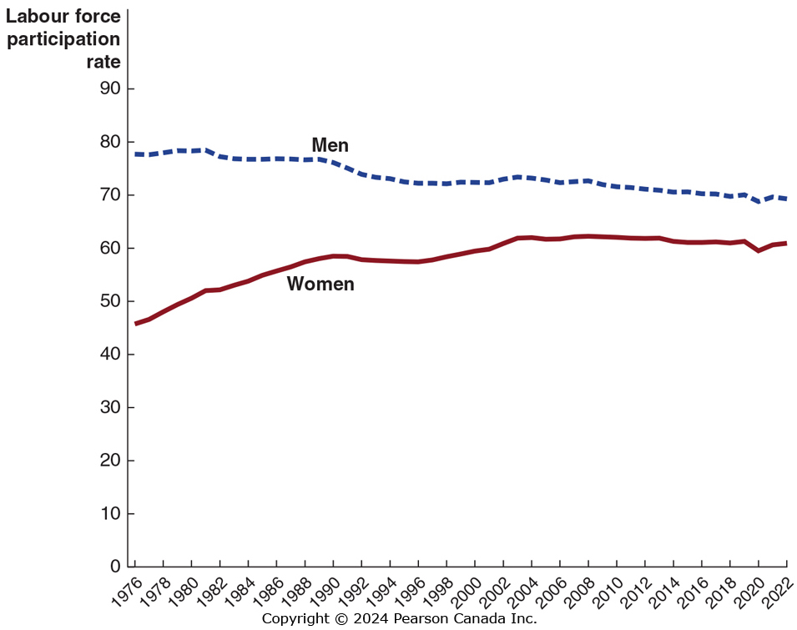
Figure 5.2 Trends in the Labour Force Participation Rate of Men and Women
Female participation has risen significantly since 1976.
More opportunities for women, improved social attitudes, smaller families.
Male participation has fallen since 1976
Longer schooling, earlier retirement.
In 2020 and 2021, participation rates by both men and women fell relative to 2019 as the Canadian economy dealt with the fallout of the global COVID-19 pandemic.
SOURCE: Statistics Canada. Table 14-10-0287-01 Labour force characteristics, monthly, seasonally adjusted and trend-cycle, last 5 months, https://www150.statcan.gc.ca/t1/tbl1/en/tv.action?pid=1410028701

Slide 11
Job Creation and Job Destruction over Time
Jobs are continually being created and destroyed in the Canadian economy.
In January 2022, 890,500 more people had jobs than at the same time in 2021.
However, the number of jobs created over the year was much larger than 890,500.
Jobs can be created and destroyed at the same time.
Between December 2021 and January 2022, the number jobs in Canada fell by just over 200,000 jobs, with Ontario losing 145,700 jobs and Quebec 63,000.

Slide 12
Types of Unemployment
5.2 Learning Objective
Identify the three types of unemployment.

Slide 13
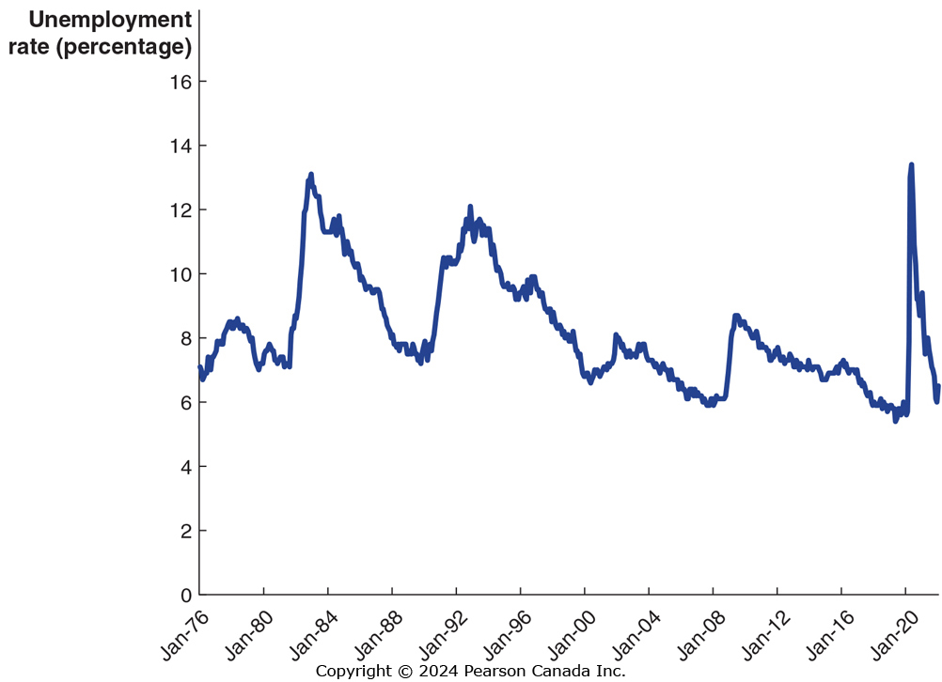
Figure 5.3 The Unemployment Rate in Canada, January 1976 to January 2022
SOURCE: Statistics Canada. Table 14-10-0287-01 Labour force characteristics, monthly, seasonally adjusted and trend-cycle, last 5 months, https://www150.statcan.gc.ca/t1/tbl1/en/tv.action?pid=1410028701
Unemployment rates rise during recessions, and fall during expansions. But they never fall to zero.
To understand why, we will examine the types of unemployment.

Slide 14
Four Types of Unemployment
The four types of unemployment are:
Frictional unemployment
Structural unemployment
Cyclical unemployment
Seasonal unemployment
We will examine each in turn over the coming slides.

Slide 15
Frictional Unemployment
Frictional unemployment: Short-term unemployment that arises from the process of matching workers with jobs.
Frictional unemployment occurs mostly because of job search: people entering or re-entering the labour force, or being between jobs.
Some frictional unemployment is unavoidable because the process of job search takes time because some workers will always be in the process of finding new jobs.
Some frictional unemployment actually increases economic efficiency by allowing for better job matches.

Slide 16
Structural Unemployment
Structural unemployment: Unemployment that arises from a persistent mismatch between the skills and attributes of workers and the requirements of jobs.
Structural unemployment is associated with longer unemployment spells.
Workers who are structurally unemployed may require retraining in order to obtain “modern” jobs and during the retraining period, they are unemployed.

Slide 17
Cyclical Unemployment
Cyclical unemployment: Unemployment caused by a business cycle recession.
In February 2009, Chrysler announced to temporarily close its assembly plant in Brampton, Ontario, due to low sales. The laid-off employees experienced cyclical unemployment.
In normal recoveries after a recession, unemployment due to cyclical factors will fall.

Slide 18
Seasonal Unemployment
Seasonal Unemployment is due to seasonal factors, like weather or fluctuations of demand due to the time of the year.
The importance of seasonal unemployment varies by region.
Seasonal unemployment can make the unemployment rate artificially high in winter and artificially low in summer.
Statistics Canada publishes two sets of unemployment figures: one that is seasonally adjusted (seasonal unemployment eliminated) and one that is not seasonally adjusted (seasonal unemployment included).

Slide 19
Full Employment
When all unemployment is due to frictional and structural factors, we say that the economy is at full employment. This means there will always be some unemployment in the economy.
Economists call this the natural rate of unemployment: The normal rate of unemployment, consisting of frictional unemployment and structural unemployment.
Economists have estimated different natural rates of unemployment for different periods.
In 2019, economists with the Bank of Canada’s Canadian Economic Analysis Department estimated Canada’s natural rate of unemployment from 1989 to 2018.
They found that the natural rate of unemployment had been falling over time and estimated the natural rate of unemployment In Canada for 2018 to be between 5.6 and 6.7 percent.

Slide 20
Explaining Unemployment
5.3 Learning Objective
Explain what factors determine the unemployment rate.

Slide 21
Government Policies and the Unemployment Rate
Governments often attempt to directly influence unemployment.
Example: The Ontario government’s “Better Jobs Ontario” program offers support to retrain laid-off workers. This would reduce structural unemployment.
Other policies try to reduce frictional unemployment, for example, by subsidizing new hires.
However, some other government policies probably increase unemployment, like:
Employment insurance, and
Minimum wage laws
We will examine the effects of each of these on unemployment.

Slide 22
Employment Insurance (EI)
Suppose you have just lost your job. You want to find another, and have two main options:
Take a new low-paying job immediately, or
Search for a better job
If employment insurance payments are available to you, you will be more likely to choose the second option.
In Canada, employment insurance will replace 55% of your earnings up to a maximum of $595 per week (in 2021). These benefits are much more generous than in the U.S., but similar to other industrial countries.
EI helps unemployed people to spend more time searching for a job that suits their skills which makes the economy more productive.

Slide 23
Minimum Wage Laws
Minimum wage laws are designed to help low-income workers; but raising the wage that firms have to pay will likely result in them hiring fewer workers.
As of June 2022, the highest minimum wage was $16/hour in Nunavut, and the lowest was $12.75/hour in New Brunswick.
Relatively few full-time adults earn minimum wage. The group most likely to receive minimum wage is teenagers.
How much unemployment does the minimum wage really cause? Economists are uncertain, but believe it is relatively small.
Studies suggest a 10% increase in the minimum wage would reduce teenage employment by about 2%.
Notes:
Data from Government of Canada website
http://srv116.services.gc.ca/dimt-wid/sm-mw/rpt1.aspx
Which contains scheduled increases as well.

Slide 24
Labour Unions
Labour unions are organizations of workers that bargain with employers for higher wages and better working conditions for their members.
Unions are probably not a significant cause of unemployment in Canada.
While they raise the wage, by the end of 2021, about 30.9% of Canadian workers belonged to a union.
The vast majority of government employees, 77.2%, are member of a union.
In the private sector, only 15.3% workers are unionized, limiting the effect that unions have on the wider economy.

Slide 25
Efficiency Wages
Efficiency wage: An above-market wage that a firm pays to increase workers’ productivity.
Firms want to get the best performance they can out of their workers. Sometimes monitoring workers is difficult or costly; an alternative is to pay them a relatively high wage, making them motivated to perform well in order to keep their job.
These above-market wages are probably another reason why unemployment exists even when cyclical unemployment is zero.

Slide 26
Measuring Inflation
5.4 Learning Objective
Define price level and inflation rate, and understand how they are computed.

Slide 27
Price Level and Inflation Rate
In the previous chapter we introduced the idea of the price level: a measure of the average prices of goods and services in the economy.
Inflation rate refers to the percentage increase in the price level from one year to the next.
In Chapter 4, we used the GDP deflator to measure changes in the price level. It excludes price of imports and include price of exports.
By measuring changes in the prices of different baskets of goods, we would come up with different measures.
Two commonly-used measures are:
The consumer price index (CPI)
The producer price index (PPI)
We will examine each in turn.

Slide 28
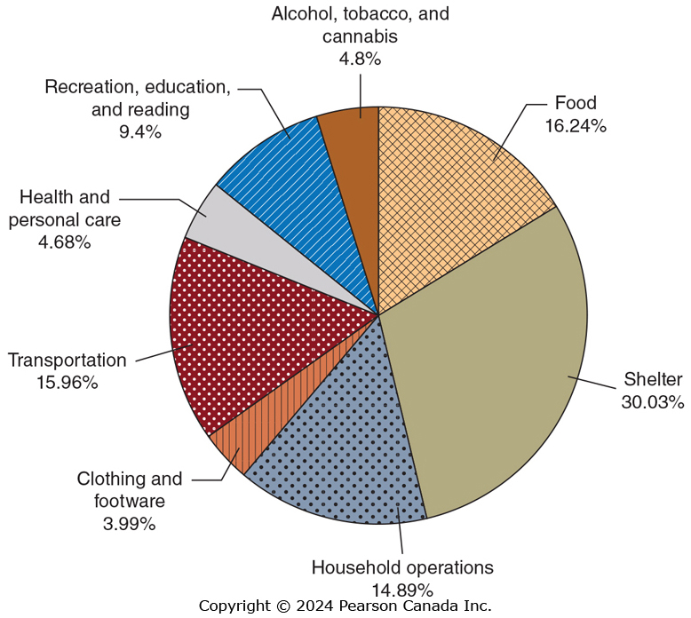
Figure 5.4 The CPI Basket, 2021
The consumer price index is a measure of the average change over time in the prices a typical household pays for the goods and services they purchase.
The chart shows the composition of the basket of goods used to create the CPI.
SOURCE: Statistics Canada, “Basket Weights of the Consumer Price Index, Canada, Provinces, Whitehorse, Yellowknife and Iqaluit,” Table 18-10-0007-21.

Slide 29
Calculating the CPI
To calculate the CPI in a given year, we need:
A basket of goods
The cost to purchase the basket of goods in a base year
The prices in the current year
The CPI in the current year is the cost to purchase the basket of goods this year, divided by the cost in the base year. By convention, we multiply this by 100, so that the CPI in the base year is 100.

Slide 30
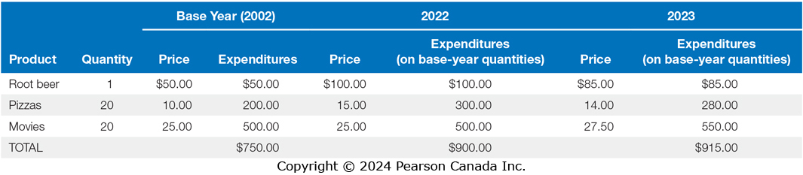
A Simple CPI Calculation (1 of 2)
The table above gives the information we need to create the CPI in 2022 and 2023, using the basket of goods from 2002.
Formula | Applied to 2022 | Applied to 2023

Slide 31
A Simple CPI Calculation (2 of 2)
Formula | Applied to 2022 | Applied to 2023
Based on these data, the inflation rate from 2022 to 2023 is the percentage change in the CPI:
Since the CPI measures consumer prices, it is often referred to as the cost-of-living index. CPI-inflation is sometimes used to generate “fair” increases in wages for workers, and government benefits.

Slide 32
Apply the Concept: Prices will Rise
Prices rise over time, but this doesn’t mean things really were “cheaper” in the past.
In 1915, a pair of cashmere socks was $0.35.
In 2021, a similar pair of cashmere socks are available for $39.00.
Does this mean that socks are more expensive now than in 1915?
The average income in 1915 would allow you to buy 963 pairs of socks. In 2021, the average income would buy 1733 pairs of socks. Relative to income, socks are cheaper now than they were in the past.
Using the CPI to convert the price of socks in 1915($0.35) into modern-day prices gives a pair of socks costing $8.13 compared to the modern price of $39.

Slide 33
Is the CPI Accurate?
There are four biases that cause changes in the CPI to overstate the true rate of inflation experienced by households:
Substitution Bias: Consumers switch to alternate goods once the price of a good rises, the constant basket doesn’t account for this.
Increase in Quality Bias: The quality of most products rise over time. A car today is more fuel efficient, safer, and more reliable than in the past. Increases in the prices partly reflect improved quality.
New Product Bias: New products aren’t included in the CPI basket right away. If a new product is introduced, for example, iPads were not in the basket before, any changes in price of iPads won’t be captured by the CPI.
Outlet Bias: When prices rise, consumers change where they shop, switching from boutiques to warehouse stores with lower prices. The CPI’s constant basket doesn’t consider this change.
These biases cause changes in the CPI to overstate the true rate of inflation from 0.5 percentage points to 1 percentage point.

Slide 34
Producer Price Index (PPI)
The producer price index is an average of the prices received by producers of goods and services at all stages of the production process.
It is conceptually similar to the CPI, in that it uses a basket of goods, but the goods are those used by producers.
PPI includes the prices of intermediate goods and raw materials. If prices of these goods rise, cost of producing final goods and services will rise.
The PPI can give early warning of future movements in consumer prices.

Slide 35
Using Price Indexes to Adjust for the Effects of Inflation
5.5 Learning Objective
Use price indexes to adjust data for the effects of inflation.

Slide 36
Using Price Indexes to Adjust Prices
Suppose your mother received a salary of $30,000 in 1993. This would have bought much more than a salary of $30,000 in 2021.
We can use the CPI to estimate the purchasing power of that $30,000 in 2021 dollars:
So $30,000 in 1993 would have bought about as much as $49,626 in 2021.

Slide 37
Real versus Nominal Interest Rates
5.6 Learning Objective
Distinguish between the nominal interest rate and the real interest rate.

Slide 38
Inflation and Interest Rates
When you lend money to someone, they typically agree to pay you back with interest. If the interest rate is 6%, for example, then a $1,000 loan paid back in a year will be paid back with $1,060.
This 6% is the nominal interest rate: the stated interest rate on a loan. But in that year’s time, prices will have risen; so the $1,060 next year is not worth the same as $1,060 this year.
We can adjust for inflation by calculating the real interest rate, equal to the nominal interest rate minus the inflation rate. (Note: this is an approximation, but it is quite accurate for low interest and inflation rates.)
If prices rise by 2% from this year to next, then your real interest rate on the loan is only 4%. This more accurately reflects the cost of borrowing and lending money.

Slide 39
Does Inflation Impose Costs on the Economy?
5.7 Learning Objective
Discuss the problems inflation can cause.

Slide 40
Is Inflation a Problem?
Sometimes inflation seems unimportant. After all, if all prices doubled overnight, it seems like nothing much would change: the prices of goods and services would have doubled, but so would your wage; so you could afford exactly as much as before.
But there are some less obvious problems with inflation. For example, inflation affects the distribution of income and wealth.
It is unlikely that everyone’s wages would increase at the same rate. Many people have long-term contracts specifying their wage in nominal terms, for example.
Also, nominal assets like cash decrease in value when there is significant inflation. If you hold much of your wealth in cash, then inflation causes a significant decrease in real wealth for you.

Slide 41
Problems with Anticipated Inflation
Inflation is easier to deal with if you see it coming like many other life problems. However, inflation causes problem even if it is anticipated:
There will be a redistribution of income, as some people’s incomes do not grow at the same rate as inflation.
Purchasing power of cash reduces due to inflation.
Firms have menu costs: the cost to firms of changing prices. Frequently changing prices are inconvenient for firms (and consumers too!) to deal with.
Investors are taxed on nominal returns, rather than real returns; so this can increase the tax due.

Slide 42
Problems with Unanticipated Inflation
When people cannot predict the rate of inflation, they find it hard to make good borrowing and lending decisions.
For example, in 1980s banks were charging 18% or more on mortgages because the rate of inflation was very high. People who bought homes were locked into high rates even when inflation subsided.
On the other hand, if banks lend money at a low rate and then high inflation takes place, the real interest rate they receive may be zero or negative; thus the risk of inflation makes banks wary of lending.
Unpredictable inflation makes borrowing and lending risky.

